Slide 1

Modul 5

Slide 2

Loop = iteration
Command to repeat one or more of statements several times.
The goal statements that do not need to be typed over and over again.
Looping commands:
  for()
  While()
  Do – while()

Slide 3

WHAT IS repeated?
HOW MANY TIMES repeated?
Terms of repetition:
  Initial value
  Boundary
  counter

Slide 4

for (initial value; boundary; counter)
{
statement which will be repeated;
}

Slide 5

int i;
for (i=1; i<8; i++)
{
printf(“UDINUS\n”);
}

Slide 6

initial value;
while (boundary)
{
statement which will be repeated;
counter;
}

Slide 7
int i;
i=1;
while (i<=7)
{
printf(“UDINUS\n”);
i=i+1;
}

Slide 8

initial value;
do
{
statement which will be repeated;
counter;
}
while (boundary);

Slide 9
int i;
i=1;
do
{
printf(“UDINUS\n”);
i=i+1;
}
while (i<=7);

Slide 10

Break command will stop the loop and get out of the loop to work on the nextstatement.

Slide 11
int i;
for (i=1; i<=10; i++)
{
if (i==5)
{
printf(“Exit by break\n");
break;
}
printf("%d\n",i);
}

Slide 12

Continue command, allowing us to skip or jump to a loop, for some reason.

Slide 13
int i;
for (i=1; i<=10; i++)
{
if (i%3==0)
{
continue;
}
printf("%d\n",i);
}

Slide 14
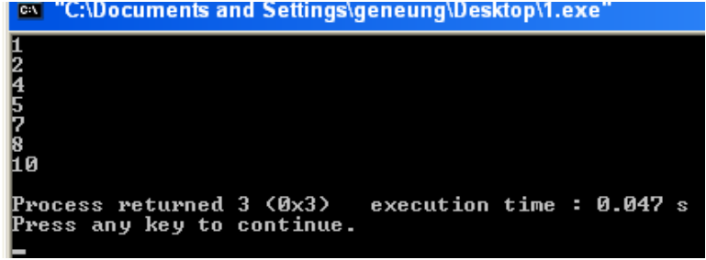

Slide 15

Loop inside of loop
int a, b;
for (a=1; a<=2; a++)
{
printf("udinus\n");
for (b=1; b<=3; b++)
{
printf("semarang\n");
}
}

Slide 16
